Slide 1
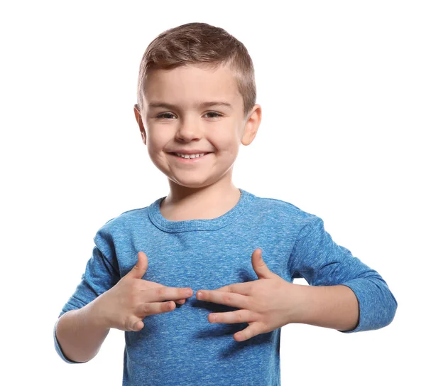
I

Slide 2

you

Slide 3
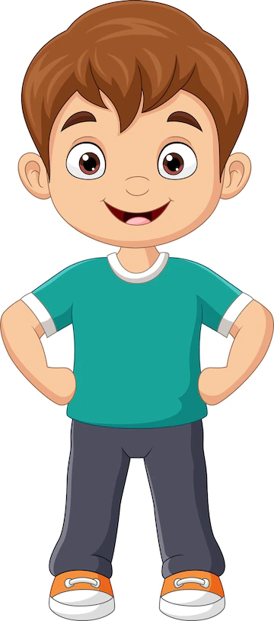
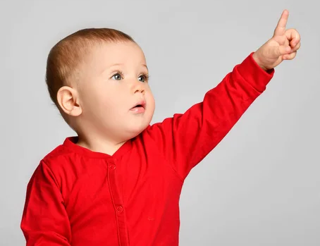
he

Slide 4
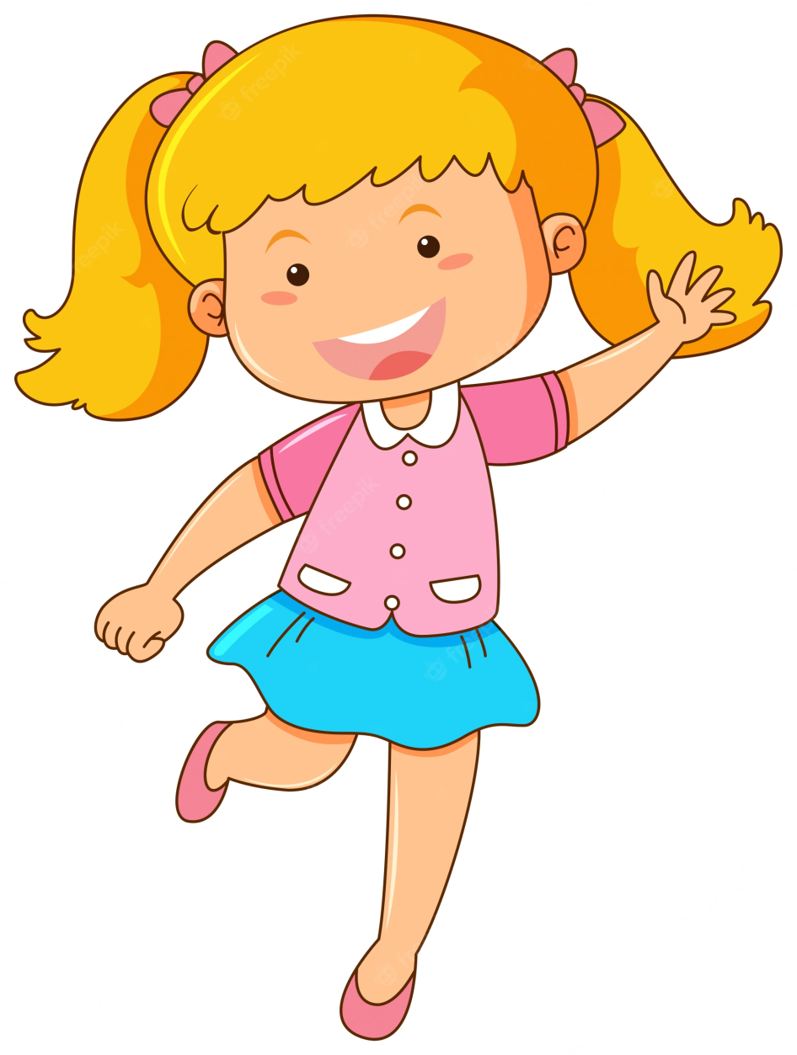
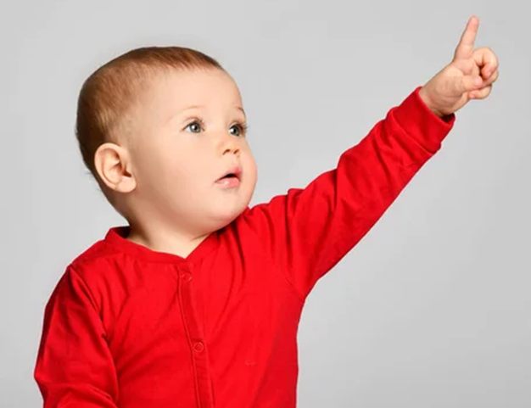
she

Slide 5

we

Slide 6
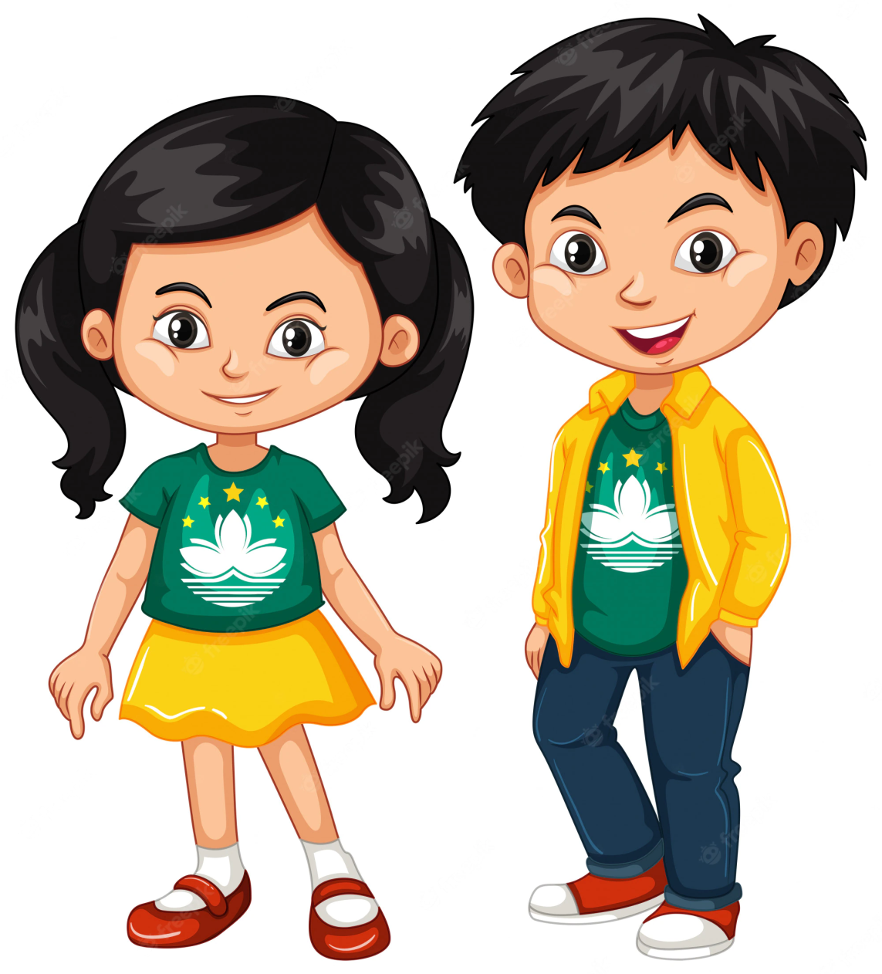
they

Slide 7


My pencil

Slide 8


Your pencil

Slide 9

His pencil

Slide 10
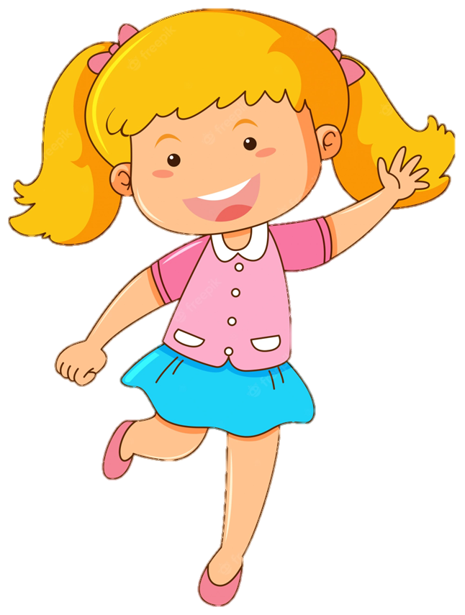
Her pencil

Slide 11


Our pencil

Slide 12


Their pencil

