Slide 1

have

Slide 2

Pass me

Slide 3


need

Slide 4

ask

Slide 5

eat

Slide 6

drink

Slide 7
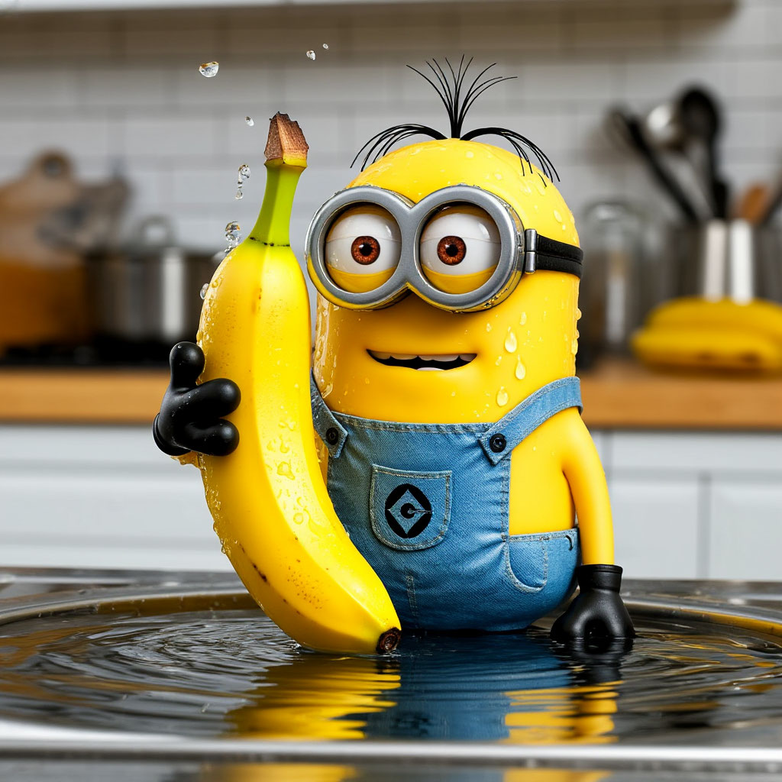
wash

Slide 8

taste

Slide 9

use

Slide 10
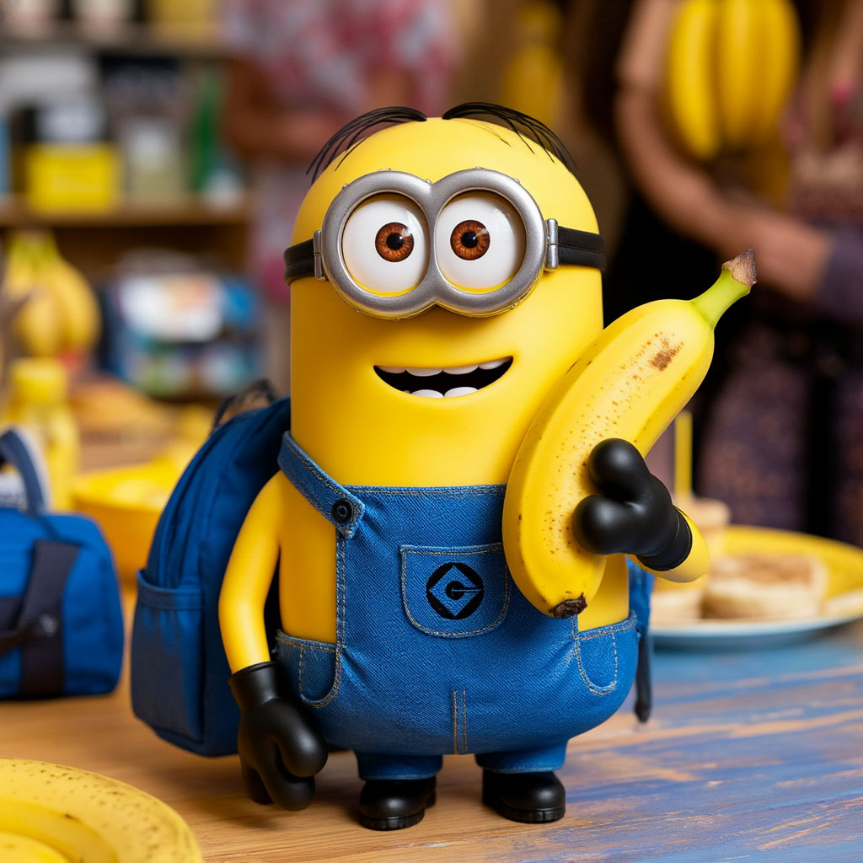
Bring a banana to the party

