Slide 1



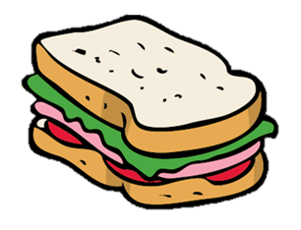
I
My sandwich

Slide 2
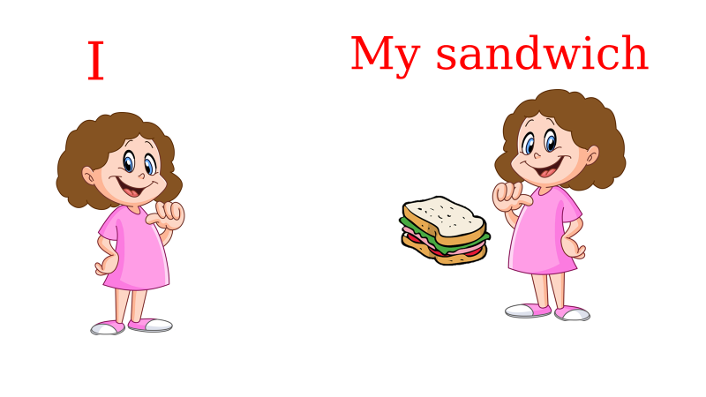

She - her

Slide 3



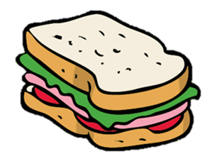
He - his

Slide 4



It – its

Slide 5

You - your

Slide 6

We - our

Slide 7



They - their

