Slide 1

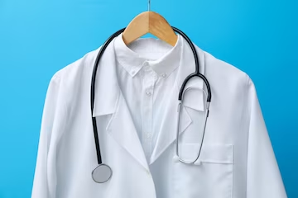
I wear a uniform.
a uniform

Slide 2

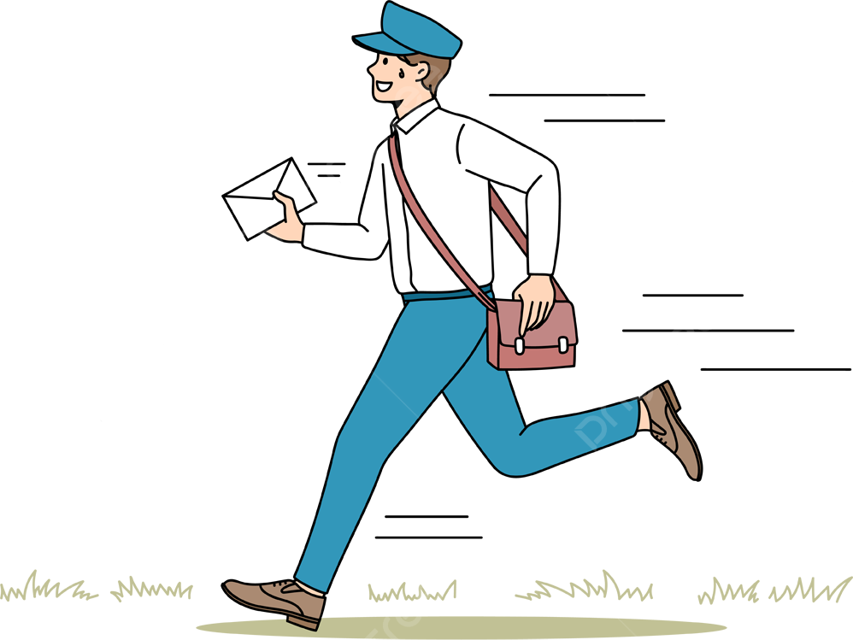
a letter
I take letters to peoples houses.

Slide 3
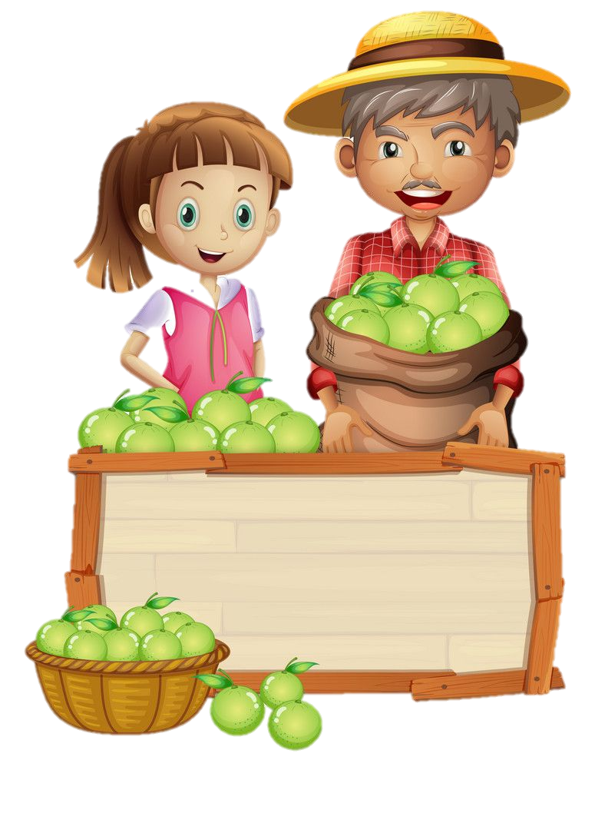
I sell fruit and vegetables.
sell

Slide 4
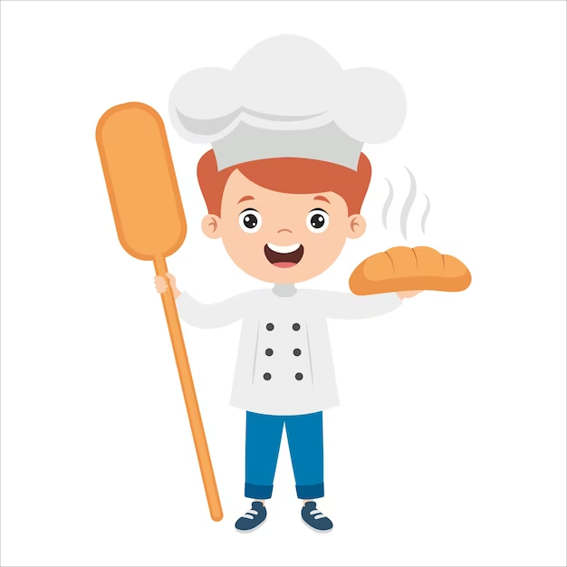
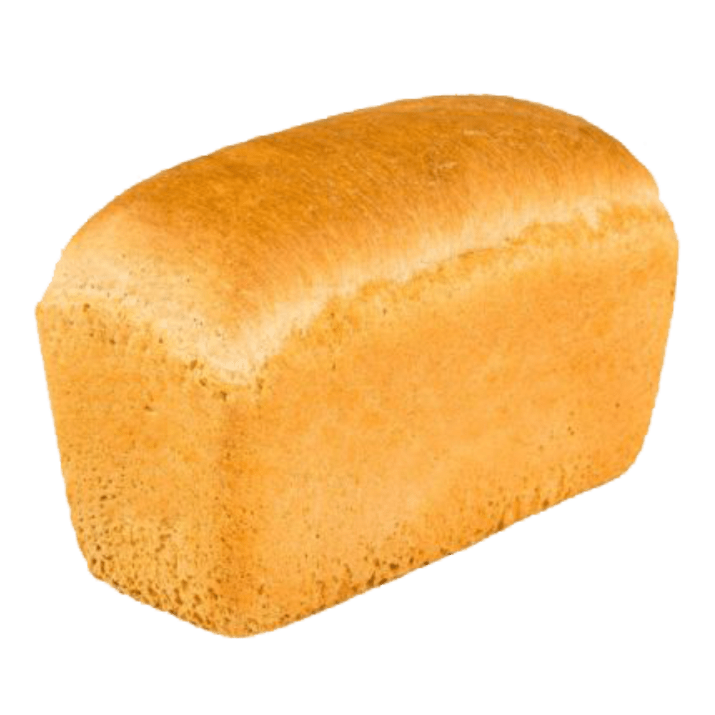
bread
I bake bread.

Slide 5


I
I fix cars.
a car

