Slide 1


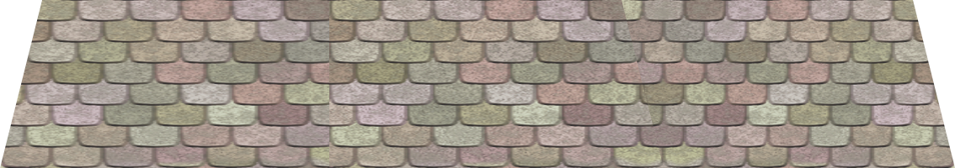


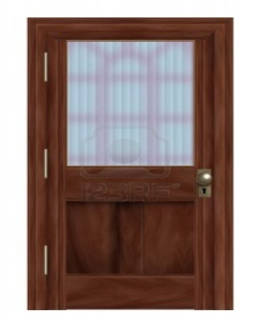
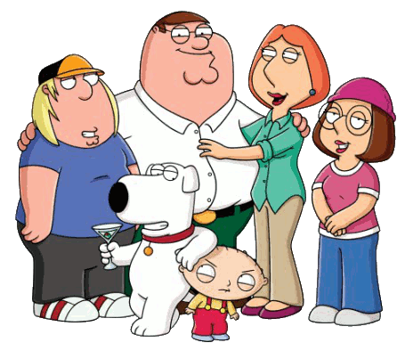
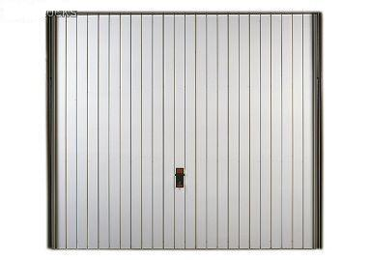



Slide 2
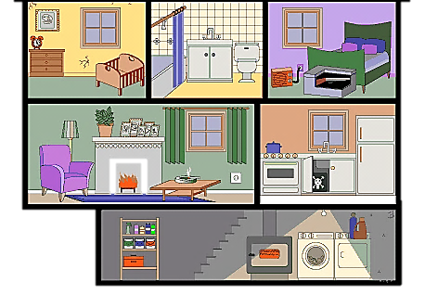



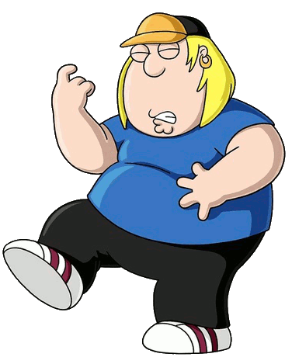


Click on the correct family member
The father is in the garage
NEXT

Slide 3
Click on the correct family member
The mother is in the bathroom
NEXT

Slide 4
Click on the correct family member
The elder brother is in the kitchen
NEXT

Slide 5
Click on the correct family member
The sister is in the living room
NEXT

Slide 6
Click on the correct family member
The little brother is in the bedroom
NEXT

Slide 7
Click on the correct family member
The dog is in the basement.
NEXT

Slide 8
The father is in the …
NEXT
kitchen
basement
bathroom
garage

Slide 9
The mother is in the …
NEXT
kitchen
basement
bathroom
garage

Slide 10
The elder brother is in the …
NEXT
kitchen
basement
bathroom
garage

Slide 11
The dog is in the …
NEXT
kitchen
basement
bathroom
garage

Slide 12
The sister is in the …
NEXT
kitchen
living room
bathroom
bedroom

Slide 13
The little brother is in the …
NEXT
kitchen
living room
bathroom
bedroom

Slide 14
The birds are on the …
EXIT
kitchen
living room
bathroom
garage

